Slide 1
Large scale fine grain simulation workflows ("Jumbo Jobs") on HPC's
erhtjhtyhy
Doug Benjamin
HEP Division ANL
On Behalf of the ATLAS Collaboration

Slide 2
Acknowledgements
Thanks to :
Wen Guan (U Wisc (US)), Tadashi Maeno (BNL (US)), Nicolo Magini (Iowa State U (US)), Paul Nilsson (BNL (US)),
Danila Oleynik (JINR (RU)), Vakho Tsulaia (LBL (US)),
Taylor Childers (ANL (US)), Martina Javurkova (U Mass (US)),
Torre Wenaus (ANL (US)), and Harvester team and HPC DevOps

Slide 3
Why Jumbo Jobs? What are they?
HPC center’s WMS (SLURM, Cobalt,…..) limit the number of submission per users.
On grid typically one batch submission per 8 cores (or so).
For ATLAS means 1 pilot per job and one job per batch slot.
On HPC’s with limited number of submissions in the queue – need multimode submissions.
At NERSC Harvester requests 250 KNL nodes per worker (batch submission)
Normal ATLAS simulation jobs 1000 events - designed for 8 cores for up to 24 hrs.
Single ATLAS simulation job for Event Service – sized to fit HPC batch submission.
(many 100k events)

Slide 4
Tools need by ATLAS
In order to run large scale simulation (Geant 4) jobs on leadership class High Performance Computers (HPC) – ie “Jumbo Jobs” – ATLAS needs to use some tools:
Harvester
Service running on edge of HPC center that connects to the ATLAS Workflow Management System - PanDA
ATLAS Event Service (ES)
Method of running simulation – as events (1-10) are simulated they written out to individual files. Each process is instructed what input events to simulate. PanDA keeps track of the simulated events.
Fine grain event simulation leads to efficient use of CPU resources.
Yoda/Droid
Software running on compute nodes to pass information between payload – AthenaMP and Harvester/PanDA server

Slide 5
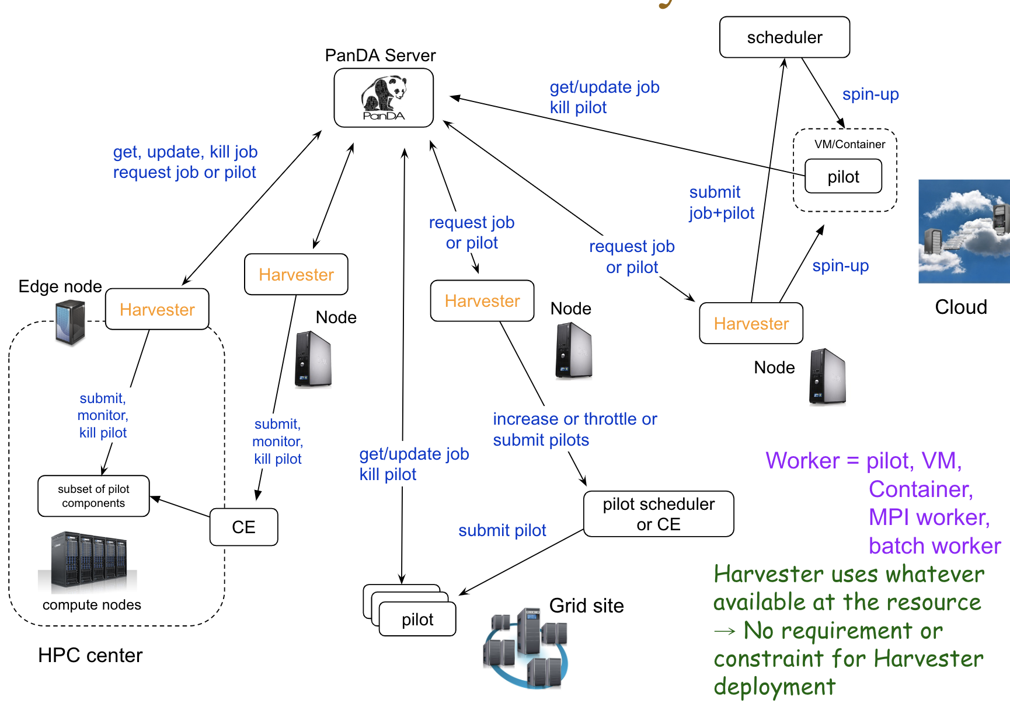
Harvester
Mediates interactions between a resource and workload/data management
Encapsulates resource heterogeneity, presenting uniform interface to workload management and monitoring
Incorporates via plugins the particular behaviour and functionality needed by a resource
Particularly suited to complex HPCs but also used across the grid
Experiment agnostic, with first usage beyond ATLAS recently reported (ASGC)

Slide 6
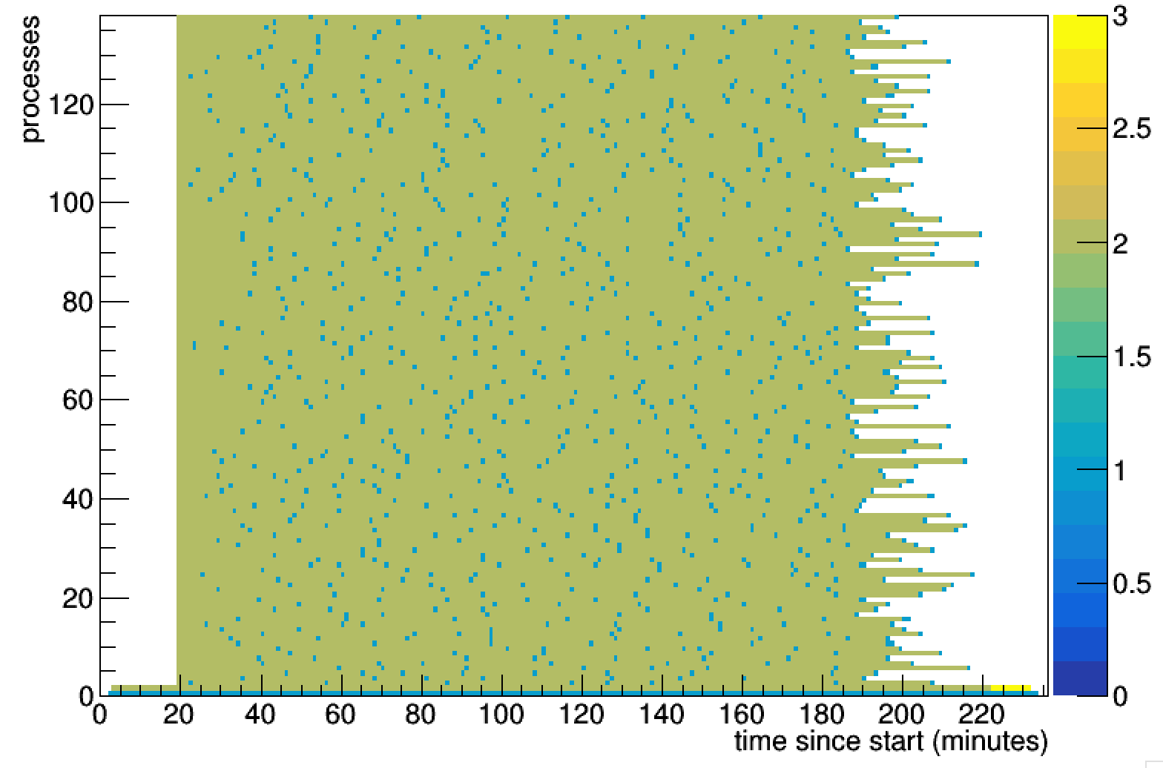
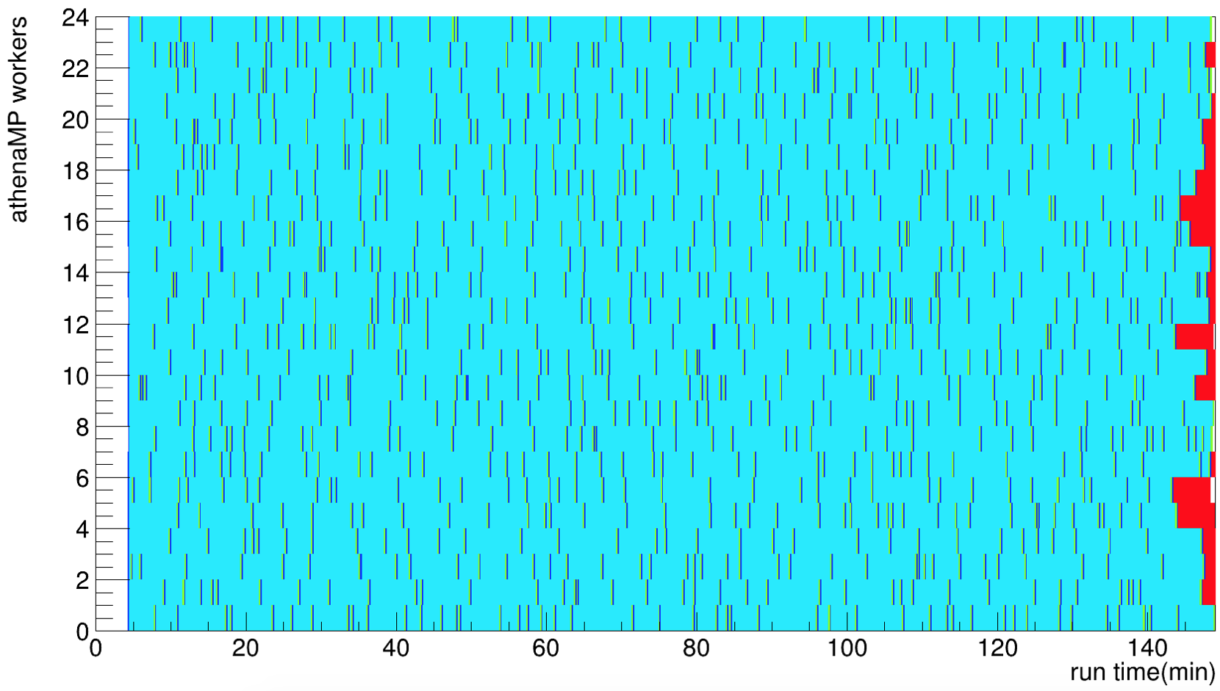
ATLAS Event Service (ES)
Efficient processor and memory utilization
In ATLAS production for several years
Without event service, each core processes N events. Once a core has finished its allocation, it idles (white)
With event service, each core is allocated events to process until the scheduler slot ends.
If the job is suddenly killed by preemption, all processed events are preserved except the last few minutes (all are lost in a conventional job)
NERSC utilization per core, no ES NERSC utilization per core with ES
128
24
# of CPU Cores
Blue: productive event processing
Red: the last interrupted event
0
220 min
0
0
time
0
time
140 min
ES elastically fills all cores for the full job lifetime

Slide 7
Yoda
yoda_droid
Rank 0
Rank 1
Rank N
Yoda
Droid
Droid
Harvester
Work Manager
Transform Manager
Transform Manager
File Manager
JobComm
JobComm
…
MPIService
MPIService
MPIService
Yoda developed by Taylor Childers ANL/ALCF
Shared File System
Queue message
MPI Communication

Slide 8
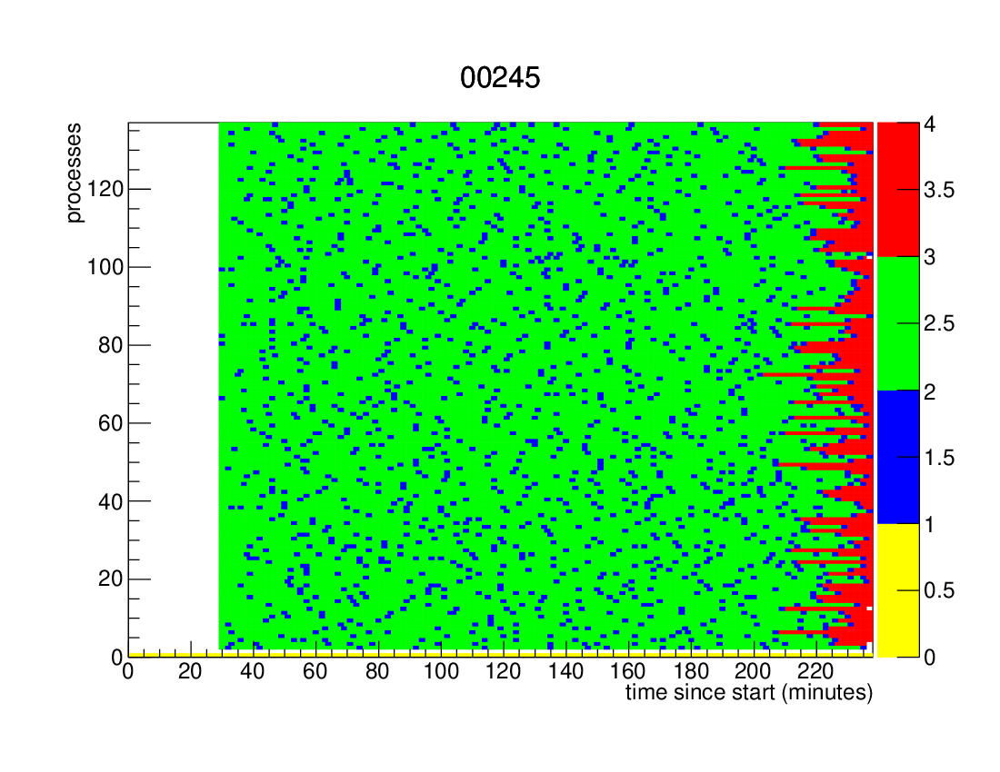
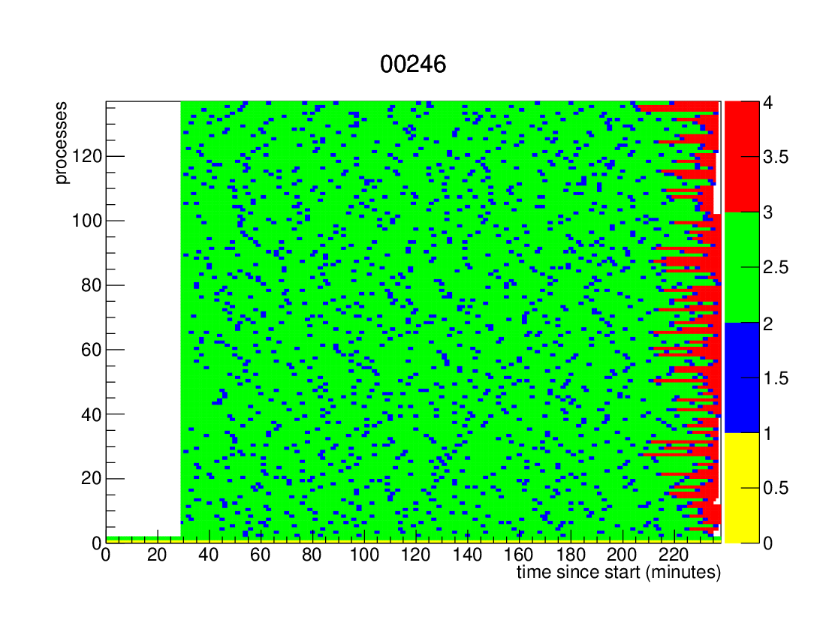
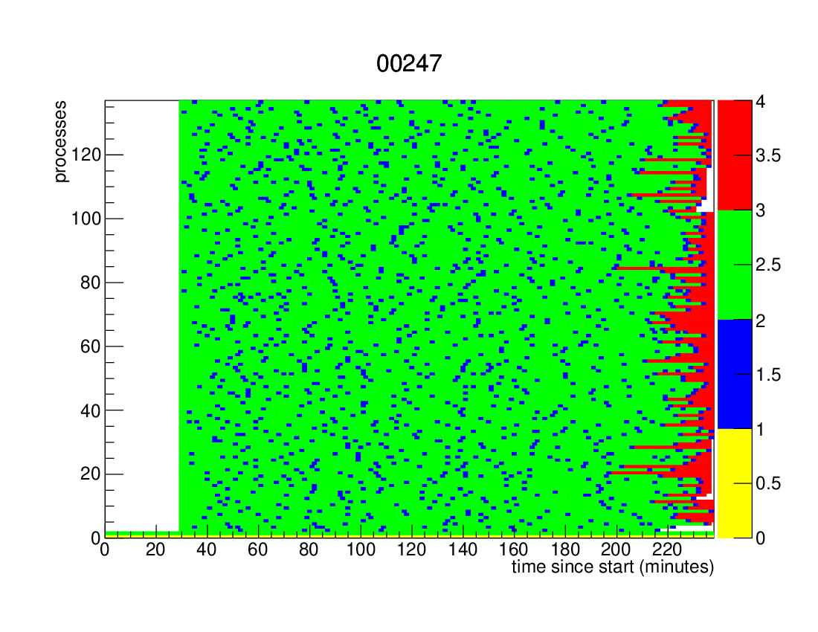
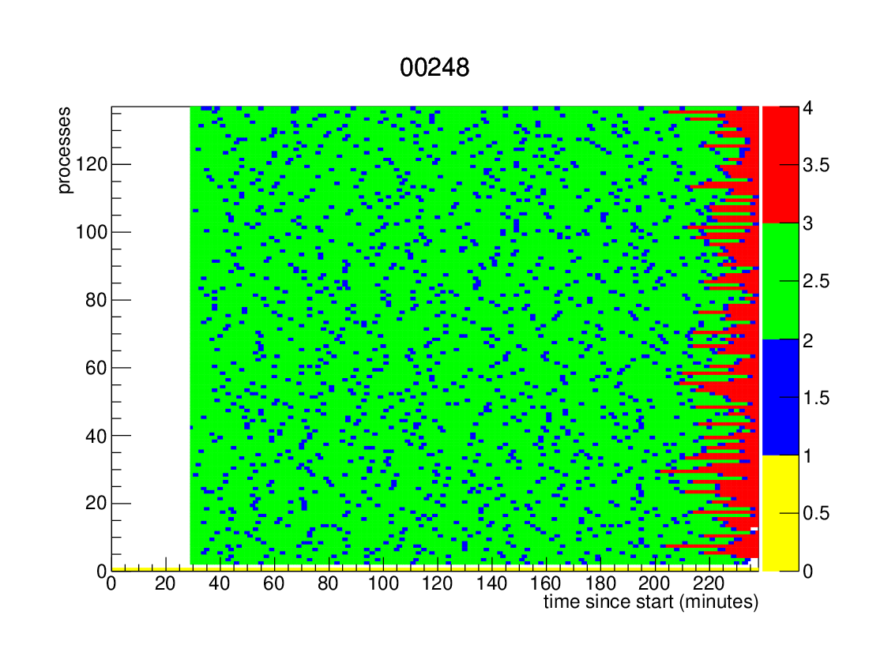
NERSC - Cori – Geant 4 Simulation
Efficient
Running
# of CPU Cores
4 Nodes in typical Jumbo job
250 nodes 34k Cores
0
0
0
time
0
time
# of CPU Cores
0
0
0
0
time
time

Slide 9
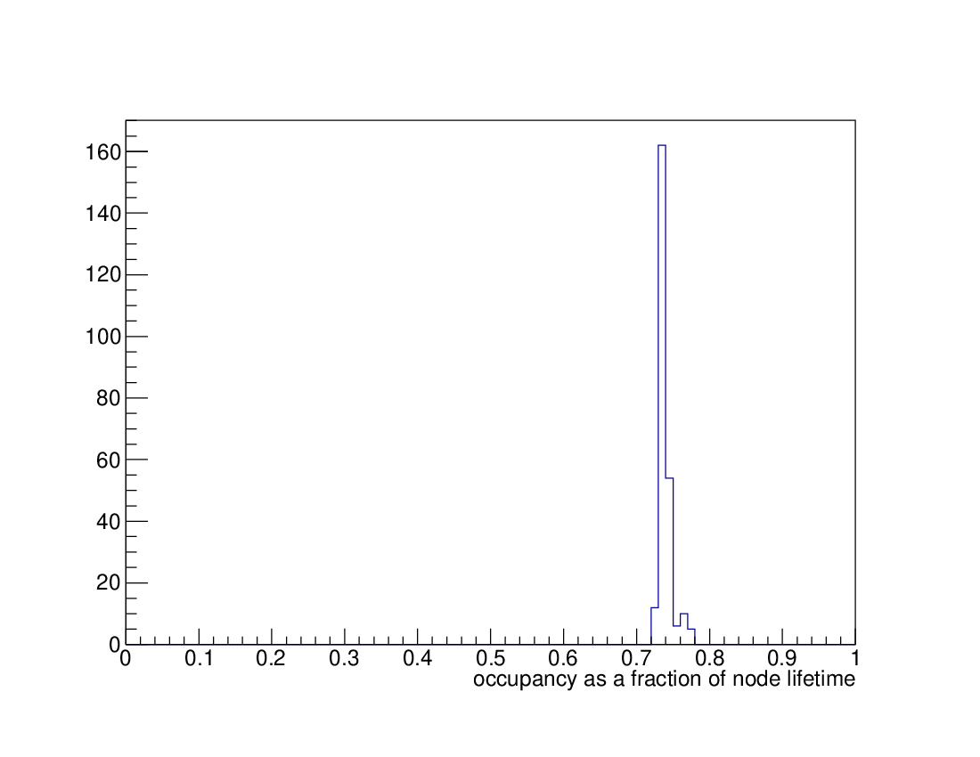
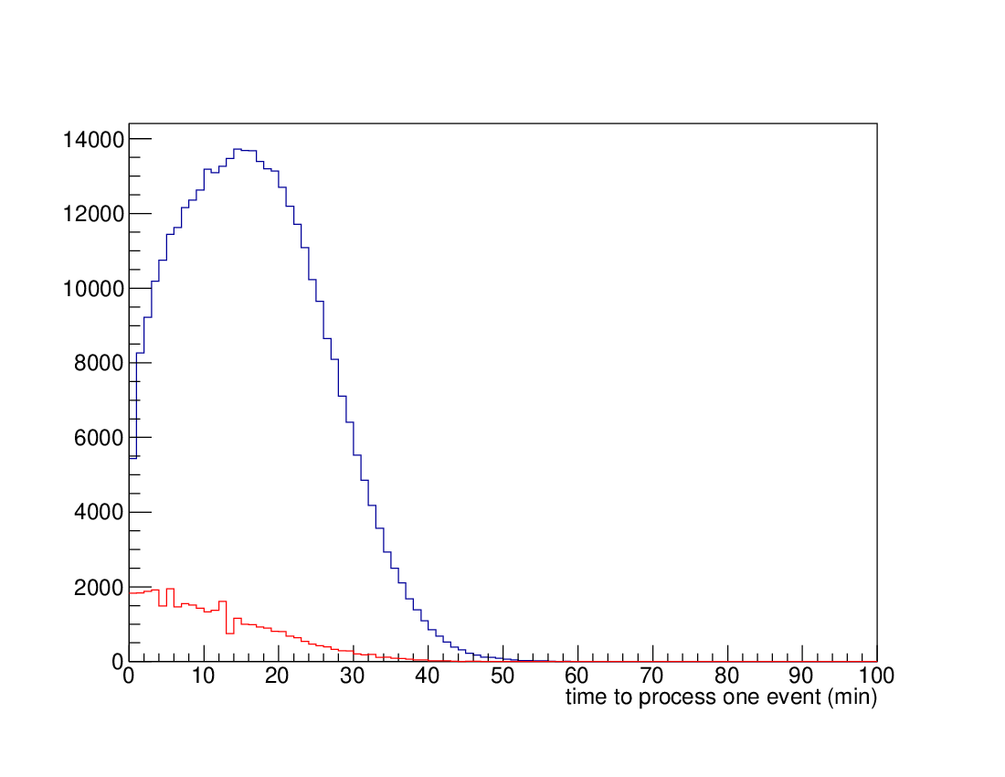
NERSC- CORI KNL nodes
Fraction of Time spent simulating events
Time spent simulating 1 event
~0.74
Blue – simulated events
Red – events not fully simulated – (at end)
0
0.7
0.8
1
0
100 min

Slide 10
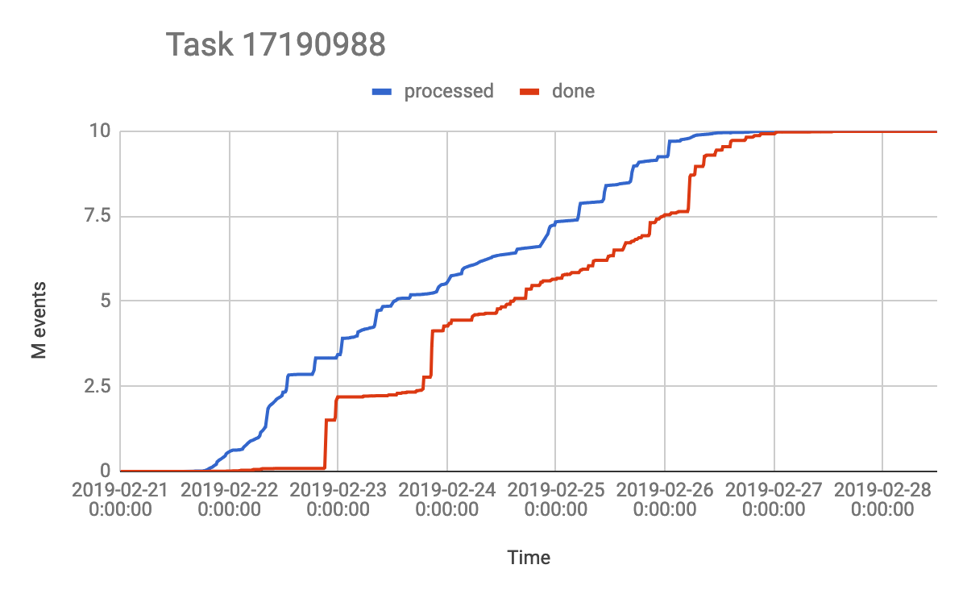
PanDA actions for Jumbo Jobs
nEvents processed
Typical event processing with Jumbo jobs
Output transfer
100%
Conversion to ES + jumbo jobs enabled
Prio boost to 900
Jumbo jobs disabled + prio boost to 500
Avalanche
Time
Boosted prio to 900 at 2019-02-26 12:45
All events processed at 2019-02-27 07:06
Manually enabled jumbo at 2019-02-21 16:08
Started at 2019-02-21 13:45
Disabled jumbo and boosted prio to 500 at 2019-02-26 01:24
Finished since all output files reached the nucleus at 2019-02-28 00:46

Slide 12
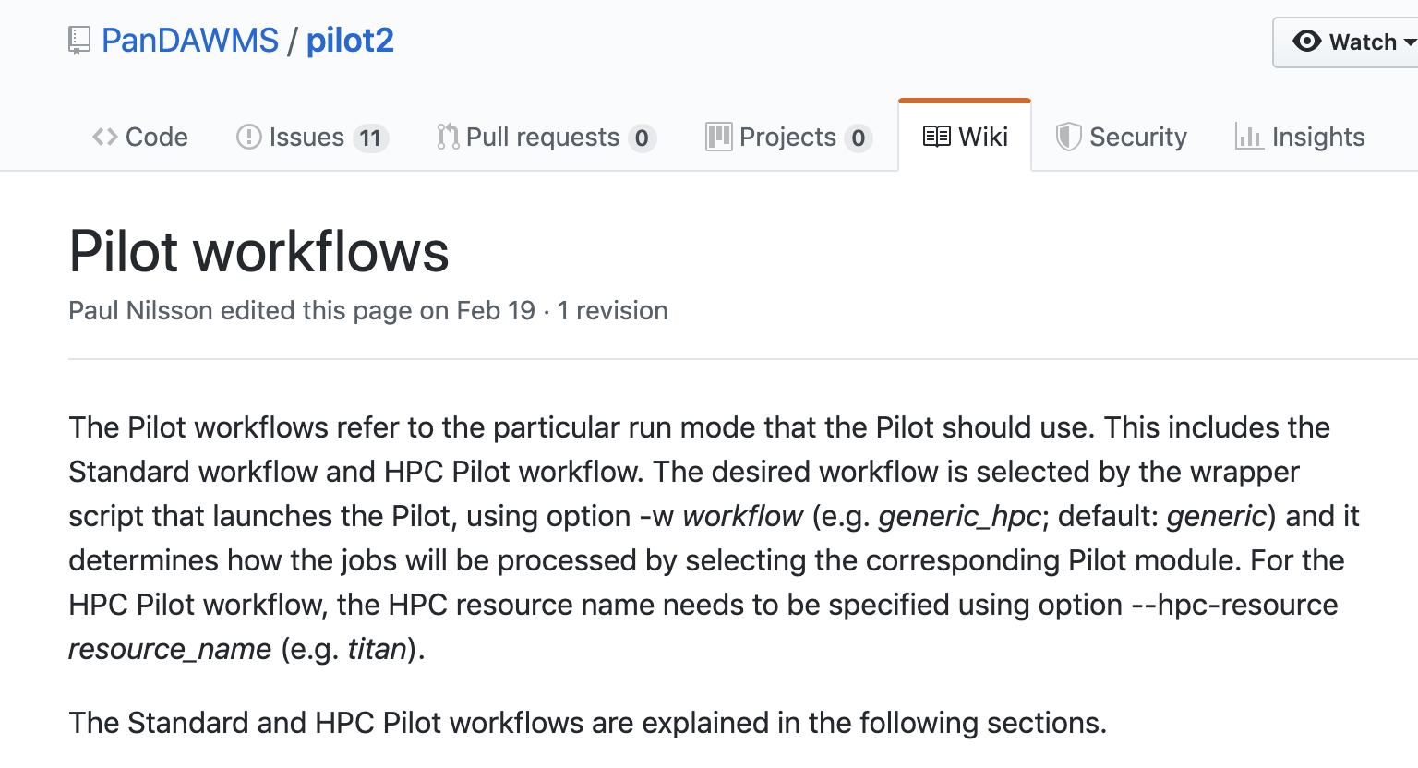
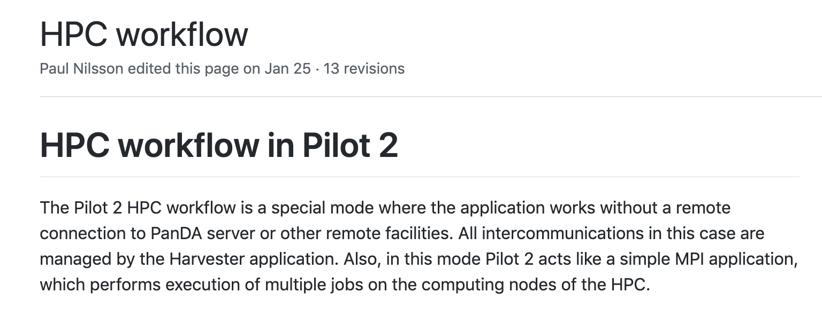
Next Steps – integration of Pilot 2
Pilot 2 – the PanDA Pilot has been modernized and rewritten
https://github.com/PanDAWMS/pilot2
Talk given at this meeting
(Tuesday - 5 – Nov)
Paul Nilsson
https://indi.to/6jVsf

Slide 13
Jumbo Jobs and Event Service have been very effective for HPC’s.
Harvester + Pilot 2 allows for better integration of HPC workflows into ATLAS Distributed computing environment.

Slide 14
Backup Slides

