Slide 1
Quadrature
Greg Beckham

Slide 2
Quadrature
Numerical Integration
Goal is to obtain the integral with as few computations of the integrand as possible

Slide 3
Equally Spaced Abscissas
Abscissas – points along a line
Considered mostly “Historical” methods
Sequence of abscissas x₀, x₁, …, x_{N-1}, x_{N} spaced apart by a constant step h.

Slide 4
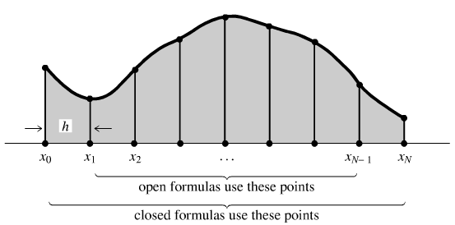
Open and Closed Integrals
Closed integrals are evaluated at the endpoints a and b
Open integrals are evaluated up to but not including the endpoints a and b

Slide 5
Closed Newton-Cotes Formulas
O is the error term
Some numerical co-efficient times h³ times the second derivative of f at some unknown point
Exact for formulas up to and including polynomials of degree 1.

Slide 6
Closed Newton-Cotes Formulas
Interval size of 2h so coefficients add up to 2
Exact for polynomials up to and including degree 3

Slide 7
Closed Newton-Cotes Formulas
Higher order methods can calculate exact integral for higher order polynomials
Better for smother functions
Not necessarily more accurate

Slide 8
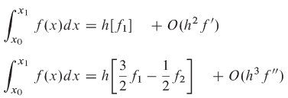
Open Integrals
Only uses interior points
Not very useful sense it can’t be extended
Extendable on upper end

Slide 9
Extended Formulas (Closed)
Perform N – 1 times and add the results together
Error expressed in terms of b and a since they are normally held constant and N is varied
- The exact error isn’t important, just the degree
Important formula that is used in practical quadrature schemes

Slide 10
Extended Formulas (Closed)
Perform N – 1 times and add the results together
Extended Simpson’s Rule:

Slide 11
Extended Formulas (Open)
Combine
To get:

Slide 12
Extended Formulas (Open)
Extended midpoint formula
Used in calculating improper integrals

Slide 13
Elementary Algorithms
Start with extended trapezoid rule
When you fix a and b, you can double the number of intervals without losing work
Continue adding intervals until it converges

Slide 14
Gaussian Quadrature
Abscissas are not equal spaced
Twice the degrees of freedom as Newton-Cotes
Formulas with twice the order but the same number of function evaluations
Weights and Abscissas can be chosen such that the integral is exact for a polynomial * some known function
To do the integral

Slide 15
Gaussian Quadrature
Weights and Abscissas are specific to a particular function and cannot be applied to others
Converges exponentially for smooth functions

